Slide 1
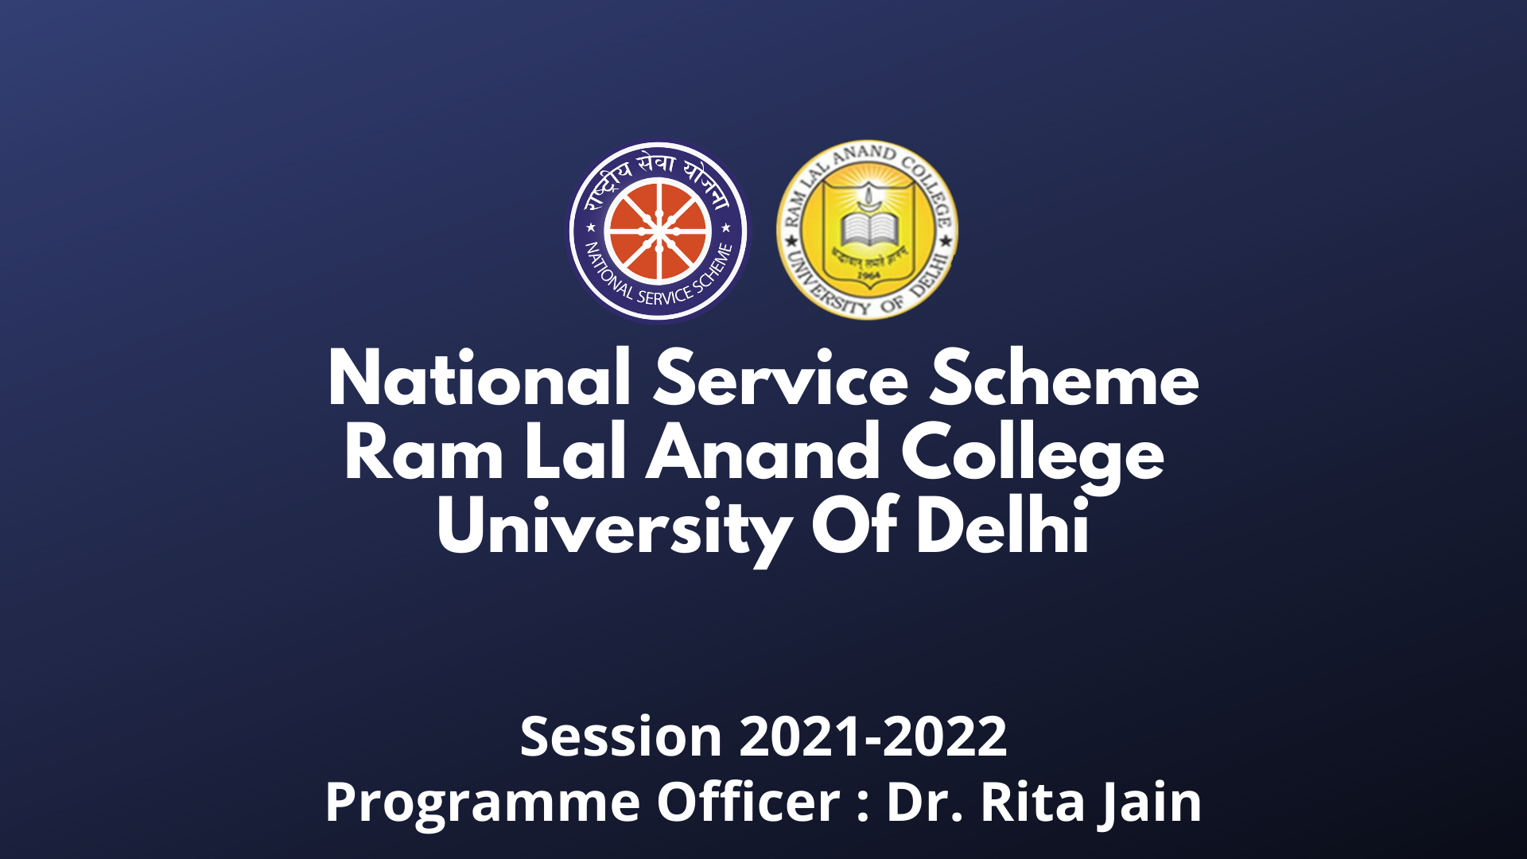

National Service Scheme
Ram Lal Anand College

Slide 2
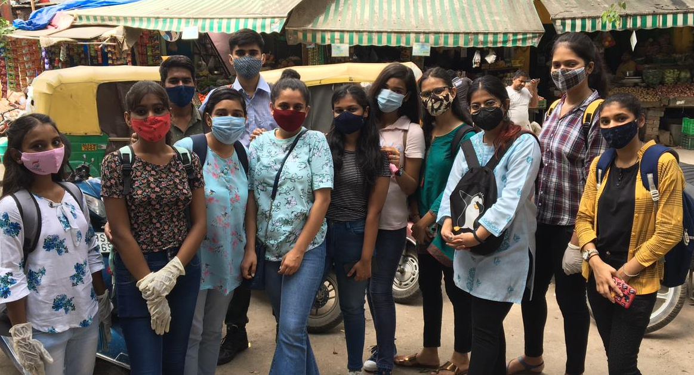
ABOUT US
The National service scheme(NSS) is an Indian government sponsored public service program conducted by the Ministry of Youth Affairs and Sports of government of India. Popularly known as NSS, the scheme was launched in Gandhiji's centenary year in 1969.
Motto: Not Me But You
The program aims to instil the idea of social welfare in students , and to provide service to society without bias. NSS volunteers work to ensure that everyone who is needy gets help to enhance their standard of living and lead a life of dignity . In doing so, volunteers learn from people in villages how to good life despite of scarcity of resources. It also provides help in natural disasters by providing food , clothes first aid etc.

Slide 3
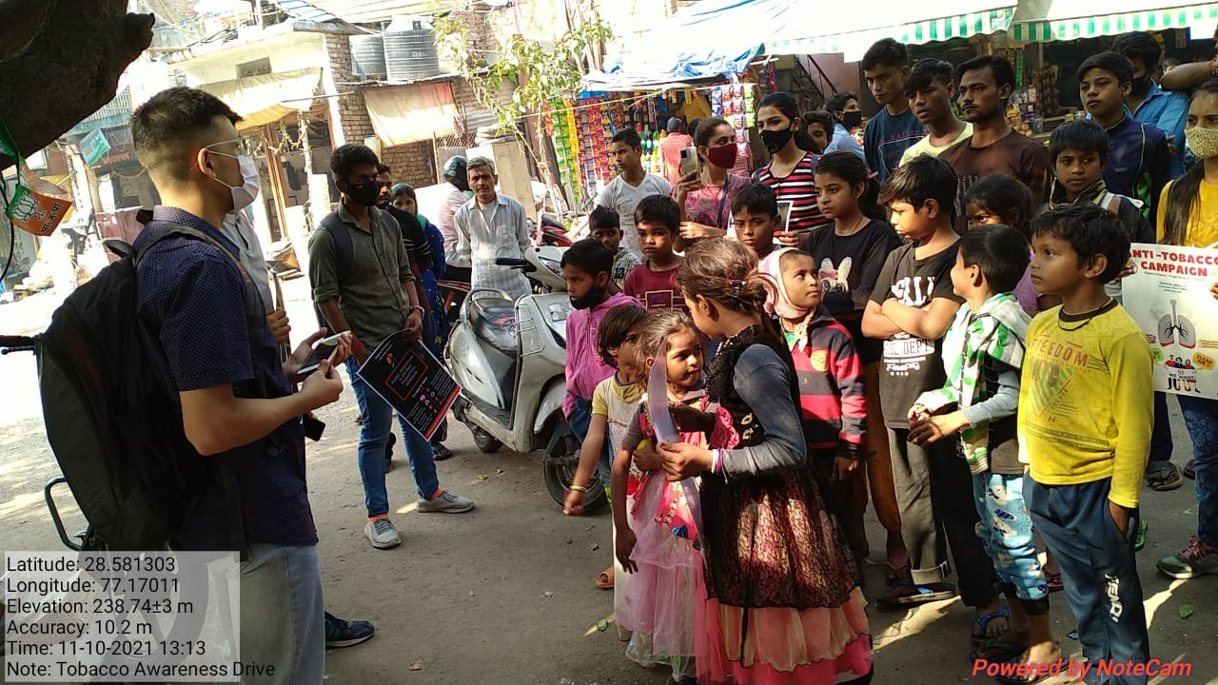
Objectives of NSS
Ensure holistic development of members.
Provide its members an open space to come up and present their ideas
Impart interpersonal and communication skills improve.
Give ample exposure which helps them in emerging as a more skilled individual .
Social Welfare of Society.

Slide 4
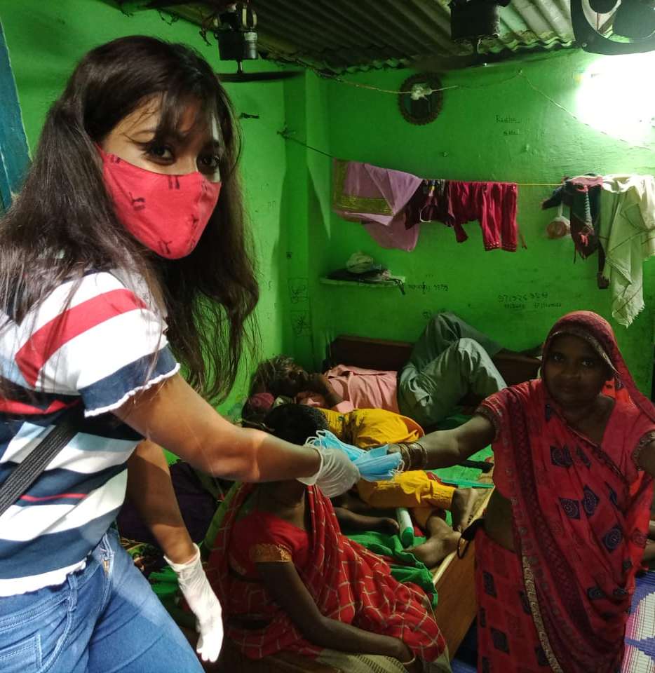
Events & Activities
Since life for the past one year has completely been in online mode, events like poster making, quiz, slogan writing, article writing, movie screening, Tarang - monthly intra unit competition, and other similar fun activities are making volunteers creative, innovative and skilful. But, finally, the unit has again started performing some major ground activities like vaccination awareness drives and Anti-tobacco Campaign since the situation and time are slowly getting back to normal.

Slide 5
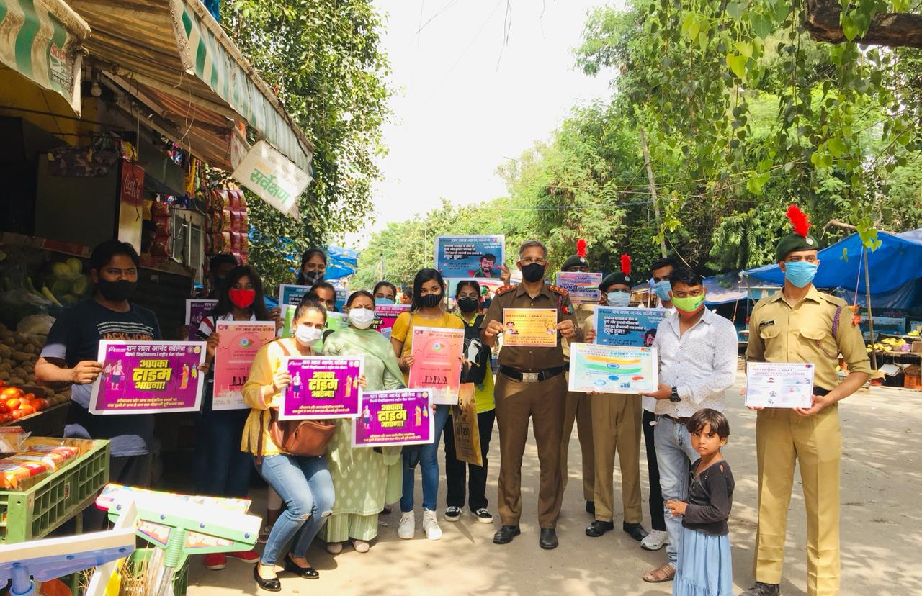
JJ Camp Vaccination Awareness Drive
9 NSS volunteers on 15th Aug & 12 volunteers on 19th Sept of Ram Lal Anand College conducted a survey on the covid-19 vaccination. A total of 200 masks were distributed among the needful ones present in the slums & a survey was conducted.346 responses were collected where we observed that those who were affected by the virus wanted to get proper treatment but couldn’t get due to the financial problems & lack of employment. Some people added that during tough times, their family members and friends provided a huge amount of support to them, and hence could get through the difficult phases of lockdown.

Slide 6
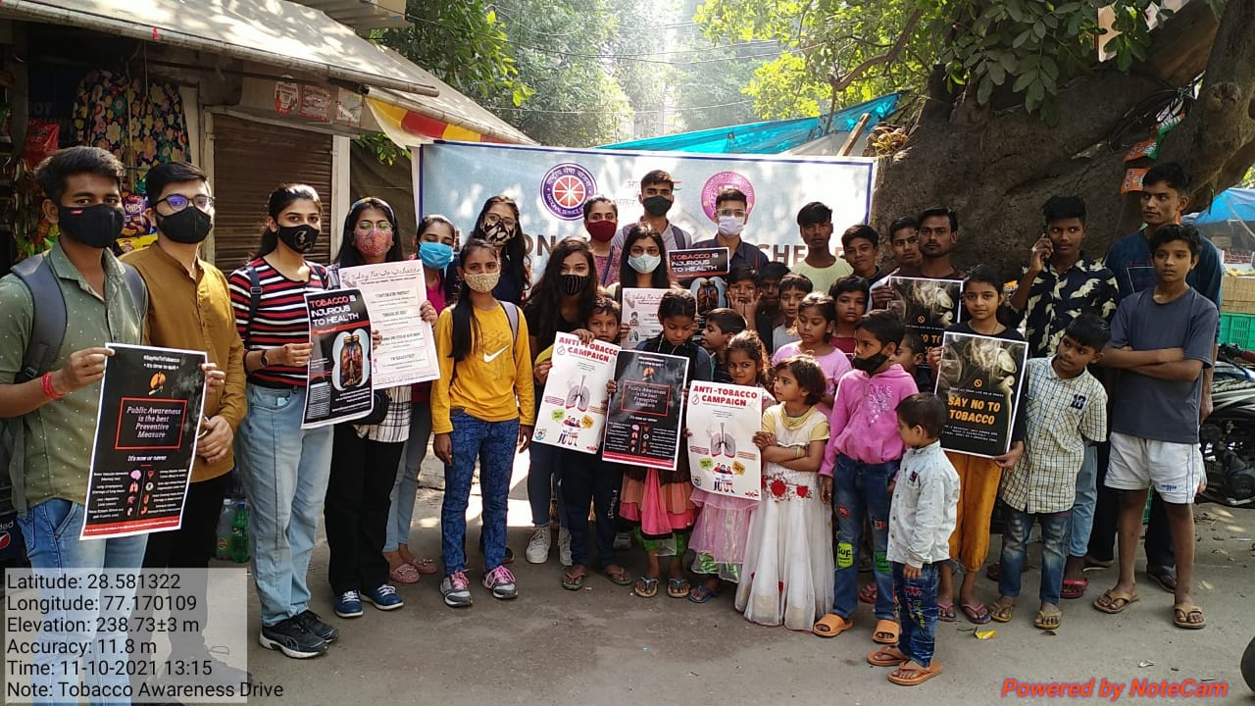
Anti Tobacco Awareness Campaign
12 NSS volunteers of Ram Lal Anand College conducted an anti-tobacco awareness campaign in order to raise attention to the widespread prevalence of tobacco use and its negative health effects. Around 30-35 people of various age groups gathered where everyone took a pledge to never consume tobacco in their life volunteers. The volunteers interacted with people and told them about the various harms caused by tobacco consumption. Team of our volunteers were able to put forward some impact for the betterment of the society, as there were a lot of people who actually understood the gravity of the situation. Creating a small difference is what it takes!

Slide 7
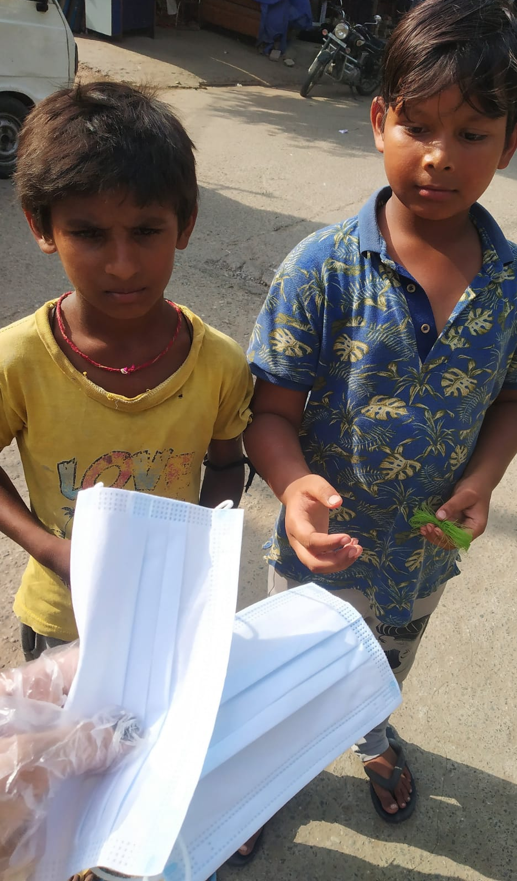
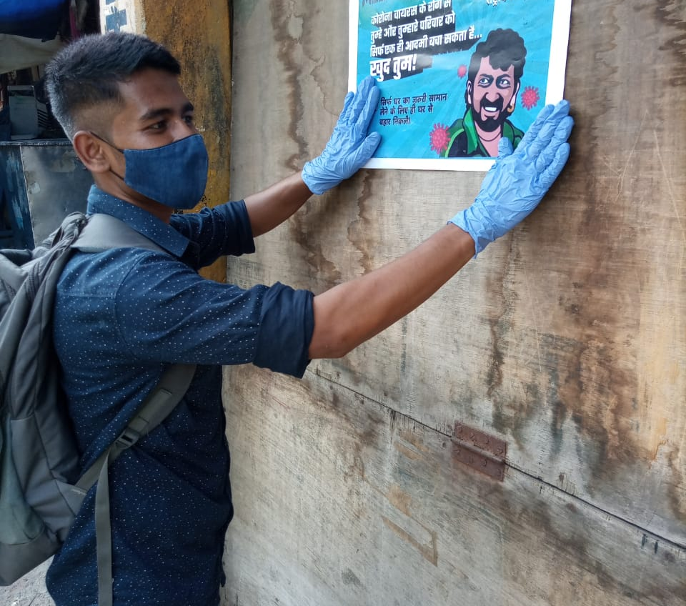
Creative Teams
Social Media
Content Writing
Graphic Designing
Event Planning
Anchoring

Slide 8
What can you Expect?
3
2
Improve your own skill sets with our intra society workshops and seminars
Enhance your CV
1
Why should you join NSS?
To be a part of social work for society
Wide Range of Events
And many more national & international camps and programs….

Slide 9
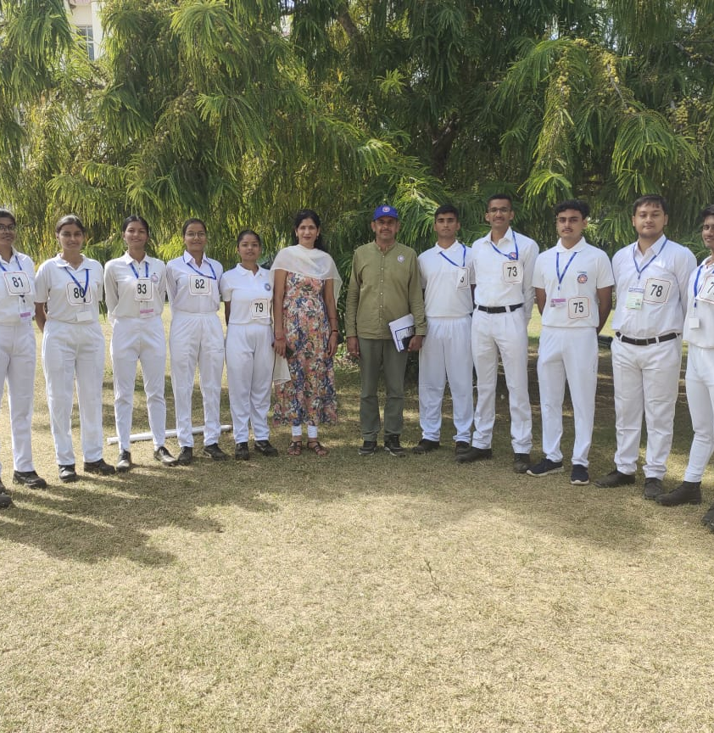
NSS Republic Day Parade Camp:
The camp takes place in Delhi between 1st and 31st January every year with 200 NSS selected volunteers who are good in discipline, March-past and cultural activities.
A Contingent of selected NSS volunteers participates in the Republic Day Parade at Rajpath, New Delhi on 26th of January every year in accordance with the guidelines and requisition of the Ministry of Defence. They also get an opportunity to meet Hon'ble President of India and Prime Minister of India.

Slide 10
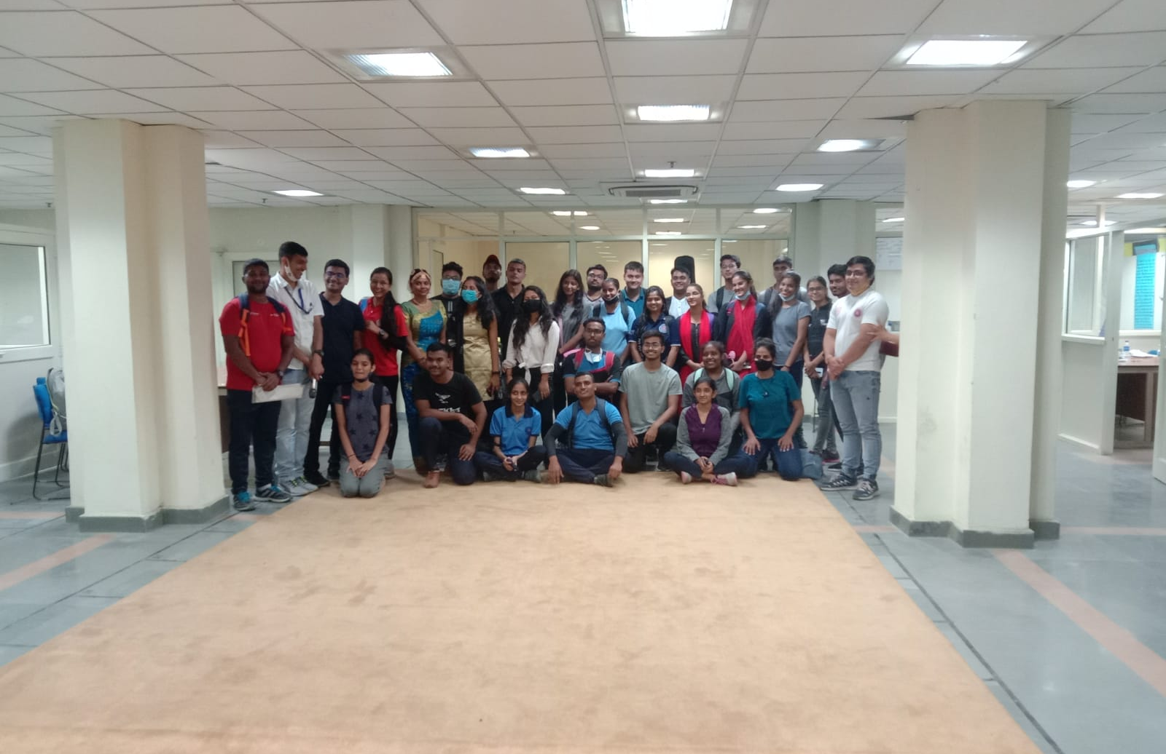
National Integration Camp (NIC)
The National Integration Camp (NIC) is organized every year and the duration of each camp is of 7 days with day-night boarding & lodging. These camps are held in different parts of the country. Each camp involves 200 NSS volunteers to undertake the scheduled activities. This camp makes volunteers aware about rich heritage and culture of India. It also develops a sense of National pride through knowledge about India.

Slide 11
Adventure Camp:
The camps are held every year which are attended by approximately 1500 NSS volunteers with at least 50% of the volunteers being girl students. These camps are conducted in Himalayan Region in the North and Arunachal Pradesh in North East region. The adventure activities undertaken in these camps includes trekking of mountains, water rafting, Para-sailing and basic skiing.

Slide 12
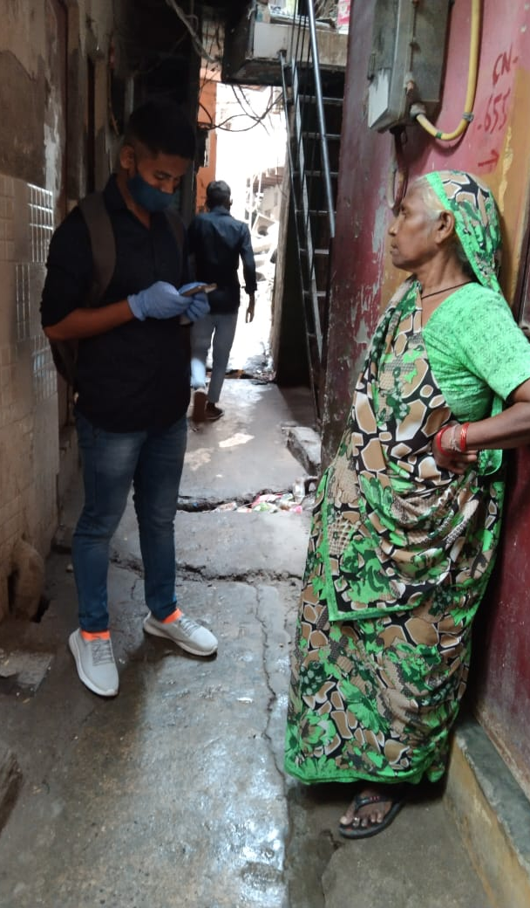
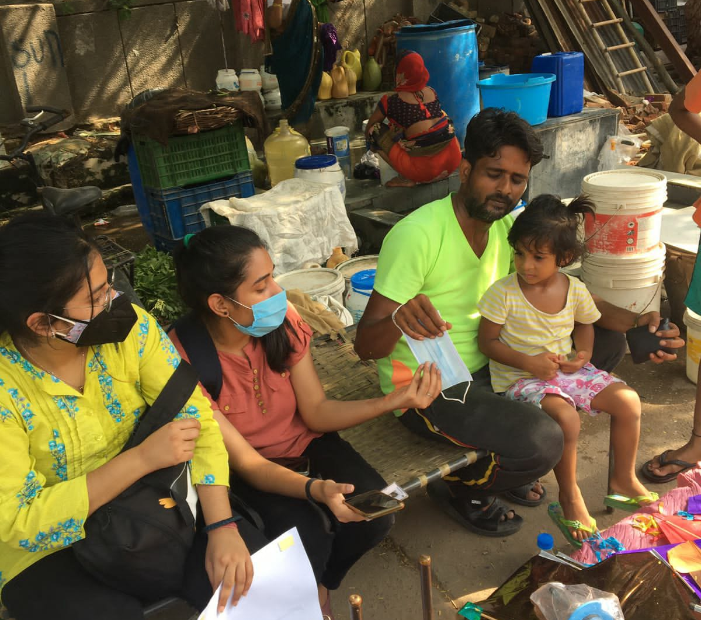
What do we Expect?
Adaptability
Team spirit
Passion
Responsiveness
Flexibility
Sense of Social and Moral responsibility

Slide 13
Achievements:
2 out of 6 volunteers selected from Delhi Directorate for Pre Republic Day Camp are volunteers of NSS RLAC.
2 volunteers participated in State Level Youth Festival.
1 NSS RLAC Volunteer welcomed and interacted with the Maldives Contingent.
NSS RLAC has undertook plantation drives and bio waste management drives on a regular basis, more than 15 volunteers practice bio-waste management.

Slide 14
Contact US:
Email: nss@rla.du.ac.in
Instagram: @nss_rlac

