Slide 1
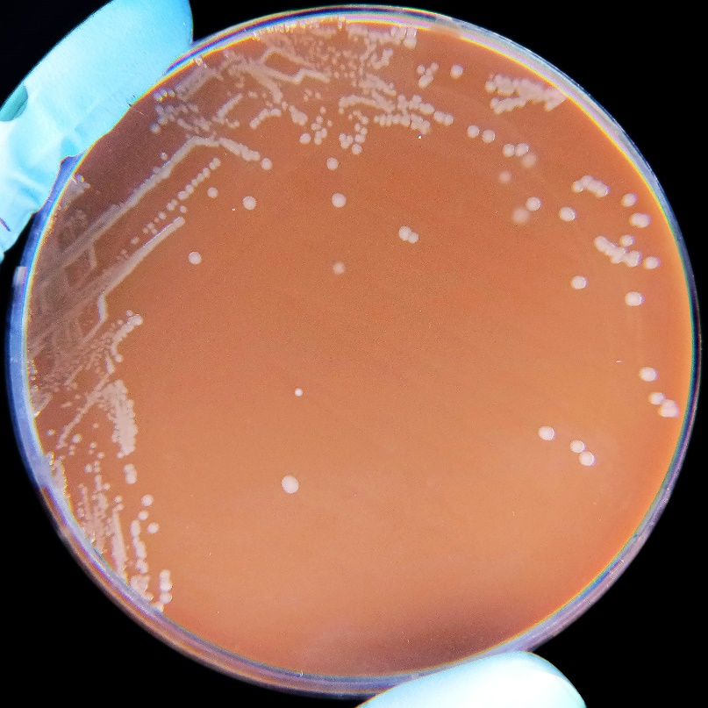
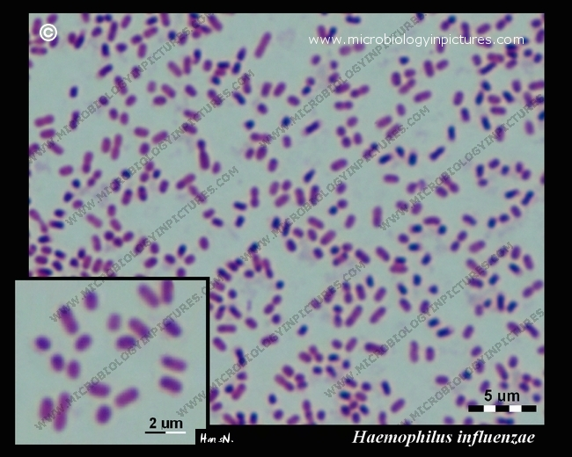
Haemophilus influenza Vanadan Gupta Semester VI Medical microbiology

Slide 2
Haemophilus influenzae (formerly called Pfeiffer's bacillus or Bacillus influenzae) is a Gram-negative, coccobacilli,
facultatively anaerobic
first described in 1892 by Richard Pfeiffer during an influenza pandemic
This species was the first free-living organism to have its entire genome sequenced

Slide 3
H. influenzae : unencapsulated strains and encapsulated strains.
Encapsulated strains: classified into six serotypes a, b, c, d, e, and f on the basis of their distinct capsular antigens
The pathogenesis is not completely understood, although the presence of the capsule in encapsulated type b (Hib), a serotype causing conditions such as epiglottitis, is known to be a major factor in resisting phagocytosis and complement-mediated lysis.
The unencapsulated strains are less invasive; they can, however, produce an inflammatory response leading to many symptoms.
Vaccination with Hib conjugate vaccine is effective in preventing Hib infection but not the infection with NTHi strains.

Slide 4
Most strains are opportunistic pathogens
Naturally acquired disease occur in humans only.
In infants and young children, H. influenzae type b (Hib) causes bacteremia, pneumonia, epiglottitis and acute bacterial meningitis.
Occasionally causes cellulitis, osteomyelitis, and infectious arthritis. It is one cause of neonatal infection
Routine use of the Hib conjugate vaccine in the U.S. since 1990: incidence of invasive Hib disease has decreased to 1.3/100,000 in children.
However, it remains a major cause of lower respiratory tract infections in infants and children in developing countries where the vaccine is not widely used.
Unencapsulated strains cause ear infections (otitis media), eye infections (conjunctivitis), and sinusitis in children, and are associated with pneumonia.

Slide 5
Signs and symptoms
Clinical symptoms: initial symptoms of an upper respiratory tract infection like viral infection, with low-grade fevers.
May progress to the LRT in a few days, resembling wheezy bronchitis.
The cough may persist for weeks without appropriate treatment.
Pneumonia occurs when the lungs become infected, causing inflammation (swelling). Symptoms of pneumonia usually include:
Fever (but older people may have lower than normal body temperature)
Cough, Shortness of breath, Chills, Sweating
Chest pain that comes and goes with breathing
Headache, Muscle pain, Excessive tiredness
Nails may turn blue from lack of oxygen
The serious complications of HiB are brain damage, hearing loss, and even death.

Slide 6
Treatment
Haemophilus influenzae produces beta-lactamases, and it is also able to modify its penicillin-binding proteins : gained resistance to the penicillin family of antibiotics.
In severe cases, cefotaxime and ceftriaxone delivered directly into the bloodstream
for the less severe cases, a combination of ampicillin and sulbactam, cephalosporins of the second and third generation, or fluoroquinolones are preferred.
Macrolide antibiotics (e.g., clarithromycin) may be used in patients with a history of allergy to beta-lactam antibiotics

Slide 7
Prevention
Hib-vaccine: available since 1990s, and are recommended for children under age 5.
The WHO recommends a pentavalent vaccine, combining vaccines against diphtheria, tetanus, pertussis, hepatitis B and Hib.
Hib vaccines cost is high. Consequently, whereas 92% of the populations of developed countries were vaccinated against Hib as of 2003, vaccination coverage was 42% for developing countries, and only 8% for least-developed countries.
The Hib vaccines do not provide cross-protection to any other Haemophilus influenzae serotypes like Hia, Hic, Hid, Hie or Hif.

Slide 8
Diagnosis
Sputum Gram stain : Gram negative cocco-bacilli are visible with a background of neutrophils.
Haemophilus influenzae requires X and V factors for growth. Haemophilus has only grown around the paper disc that has been impregnated with X and V factors
Chest X-ray :
Clinical diagnosis : typically performed by bacterial culture or latex particle agglutinations.
Diagnosis is considered confirmed when the organism is isolated from a sterile body site eg CSF or blood.
cultures from the nasopharyngeal cavity or sputum would not indicate H. influenzae disease, because these sites are colonized in disease-free individuals

Slide 9
Bacterial culture performed chocolate agar, with added X (hemin) and V (nicotinamide adenine dinucleotide) factors at 37 °C in a CO₂-enriched incubator.
Colonies of H. influenzae appear as convex, smooth,
H. influenza: grows in the hemolytic zone of Staphylococcus aureus on blood agar plates; as the hemolysis releases factor V which is needed for its growth.

Slide 10
