Slide 1
Taxonomy/Systematics
The science for studying classification is called Taxonomy (Greek: taxis = arrangement; nomos = law) AND is further divided into three working groups: Classification, Identification and Nomenclature.
Classification : placing organisms within groups with members exhibiting similarities (structure, physiological or evolutionary relatedness). These groups are termed as taxa (s. taxon)
Nomenclature is assigning of scientific names to taxonomic groups in accordance with accepted rules.
The term systematics sometimes is referred synonymously with taxonomy. While, taxonomy is plainly referred to identification, classification and naming of organisms; systematics is the evolutionary history of organisms through time.

Slide 2
The importance of taxonomy has been ever increasing.
In 2000, a project called “All Species Inventory” was started (http://www.all-species.org/).
Aim : to identify and record every species of life by 2025.
Very challenging; till now 1.5 million species- identified
Estimated mumber of species: between 7 to 100 million.
For This mind boggling number : important of cataloguing the species in a proper and scientific way.
Thus taxonomy is important for
effective communication among scientists about the identity of a particular microbe
catalogue a large number of species in a systematic manner,
help in predictions and further research about a particular isolate if little is known about it and it shows some similarities with microbes of particular group

Slide 3
2. Binomial nomenclature
For millions of organisms, common names - lead to misunderstanding as different names are used for same organism in different places.
a naming system –introduced : termed “scientific nomenclature”.
Every organism is given a binomial latin name first described by Carolus Linnaeus.
The first part : genus which is followed by species. For example; humans are assigned scientific name as Homo sapiens.
alwaysitalicized (Homo sapiens), where genus name starts with a capital letter.
Abbreviated as H. Sapiens

Slide 4
Rank Example of taxonomic hierarchy
Domain Eukarya
Kingdom Fungi
Phylum Ascomycota
Class Hemiascomycetes
Order Saccharomycetales
Family Saccharomycetaceae
Genus Saccharomyces
Species cerevisiae

Slide 5
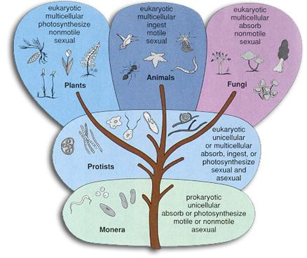

Slide 7
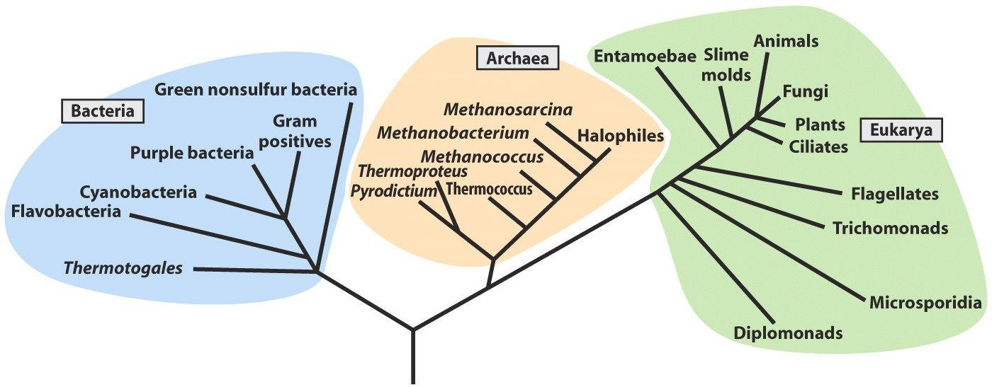
Carl Woese’s three kingdom classification:
based on rRNA sequencing

Slide 8
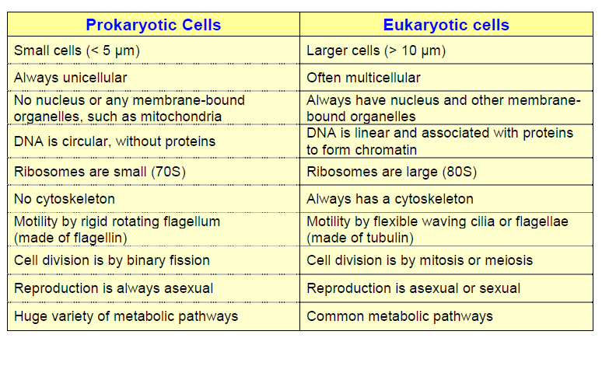
Exception: linear choromosomes found in Borrelia burgdorferi (lyme dis),
Sterptomyces lividans, S. Coelicolor, Rhodococcus fascians.
A. tumefaciens: one ln and one circular genome.
Linear plasmids in bacteria: S. rochei, Nocardia opaca, Thiobacillus versutus

Slide 9
DNA Polymerases in prok. I, II, III, IV, V
In eukaryotes: alpha, delta, epsilon, gamma
Prokaryotes:
no introns in genome
Transcription and translation are coupled
Polycistronic mRNA

Slide 10
